Slide 1


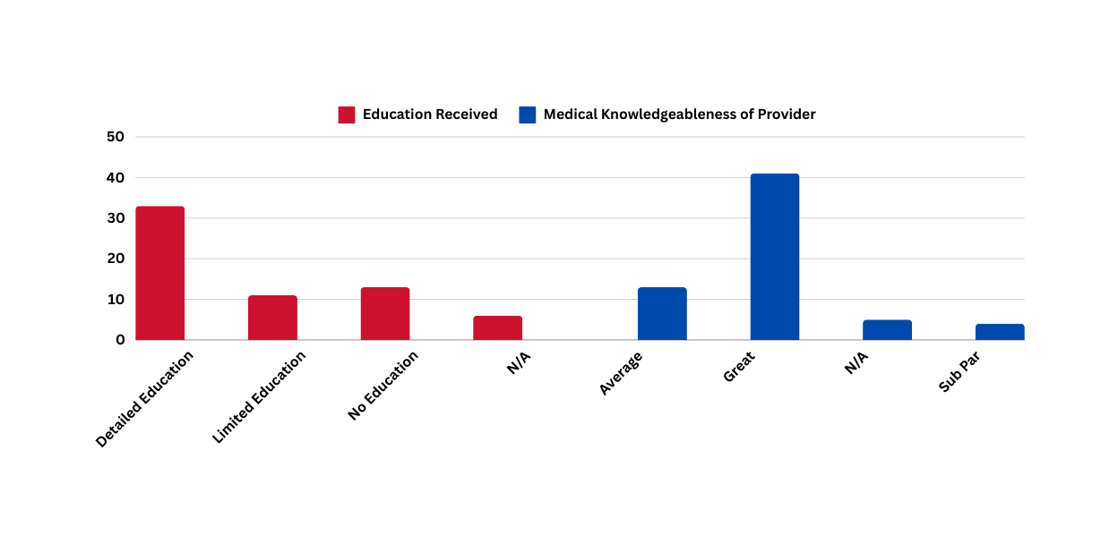


Barriers Associated with Cardiovascular Disease and the Impact of Primary Care Leading to Necessary Emergency Department Visits in The Central Valley
Tanisha Garcia, Ph.D., Emanuel Alcala, Ph.D., Shareen Purewal, BS, Ashley Garispe, D.O., Travis Helm, M.D.
Department of Public Health California State University, Fresno, Central Valley Health Policy Institute, and St. Agnes Medical Center
Background
Methods
Conclusion
In the Central Valley, residents may experience a higher rate of cardiovascular disease due to socioeconomic and environmental factors. Even though death rates from cardiovascular disease have declined in California, disparities remain. There is an increased risk of cardiovascular disease among people with low levels of income and education. The Central Valley has the highest rates of poverty and poorer socioeconomic conditions relative to the rest of California. The area is dominated by low-wage farm and service jobs and has average employment income behind the rest of the state (Garcia et al., 2020). Additionally, there are clear socioeconomic factors that may contribute to CVD in the Central Valley. Transportation, cost of healthcare, access to care, and overwhelming response to care for others first are just a few. Many individuals face transportation hardships in accessing primary care. Purpose of this study: The research identified barriers associated with cardiovascular disease and the impact of primary care leading to emergency department (ED) visits in the Central Valley.
A semi-structured 16-question interview was conducted at St. Agnes Medical Center in order to gain a fuller understanding of the involvement of primary care providers and their interactions in educating individuals about CVD. Population: The study focused on those with a primary diagnosis of a cardiovascular-related event when coming to the emergency department. The team acknowledges the inclusion criteria is a sensitive population. However, the likelihood of the admitting issue being an urgent case does not happen too often in the ED and we obviously did not interrupt these cases (for example, a STEMI that needs to go immediately to the Cath lab). However, there are many other diagnoses where patients get admitted for cardiovascular issues (chest pain, shortness of breath, and heart palpitations are just a few). In this case, they usually stay in the ED for 5-6 hours before they are taken upstairs. Results: 54 of the total 63 participants report having access to primary care however, some patients expressed they never had access to a cardiologist. Many of the participants (41 of 63) were confident that their care providers were greatly knowledgeable. A total of 46 of the 63 participants felt adequately cared for, while eight of the participants felt that the care, they received was not adequate by reporting that the care was bad or inadequate. Participants expressed that there were some challenges in receiving accessibility of care and many faced socioeconomic challenges. The study also inquired on whether the participants received education of the type of diagnosis they had and on the medication they received. Again, most of the participants reported receiving detailed and elaborate education on their diagnosis and medication. Eleven out of the total 63 participants reported receiving only a partial or limited education, where they were only given the diagnosis but no elaborate explanation. Another 13 of the 63 participants reported receiving no education whatsoever regarding their diagnosed disease or medication. Health literacy is important for each one of us. During our lives at some point in time, we will need to understand, have access to health information, and use the services provided to prevent negative health outcomes. In turn, providing in-depth health literacy to those diagnosed with CVD, will protect their well-being and enable all to manage their healthcare diagnosis when it occurs. The remaining six participants chose not to report on the education that they had received.
The findings of this study indicate there are many socioeconomic factors that, when not favorable, can lead to inadequate care towards the patient. Some participants faced barriers that prevented them from accessing better or adequate health care. Therefore, strategies to improve the care provided to diagnosed patients should be informed and guided by the influence that these socio-economic factors have with regard to the healthcare experience. From the participants' responses, the study identified socio-economic factors that impact care. This study manages to tie together the different aspects of patient barriers when receiving healthcare for CVD and the use of primary care physicians relating to ED visits. It identified the needs of those diagnosed with cardiovascular disease and the socio-economic challenges they faced. Addressing health literacy is not just a Central Valley priority, it is a national priority. Personal health literacy is important to CVD. It is the ability to understand and find useful information and services that are related to healthcare decisions and outcomes.
Marginalized populations can benefit from personal health literacy with the potential to decrease health disparities.
41
33
11
13
13
For additional information please contact:
Tanisha Garcia, Ph.D., MHA
Tanisha@mail.fresnostate.edu
559-278-6125
6
5
4

